Slide 1
Informing cell models with genomics analysis (and vice versa)
James Eddy — Sage Bionetworks
2018 mini-DREAM :: Module 7
July 31st 2018

Slide 2
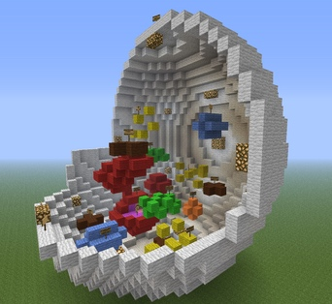
What is a (cell) model?
“A model is a simplification or approximation of reality…” ~ Burnham & Anderson
https://twitter.com/chriswejr/status/263998457805680641

Slide 3
Why build models?
“A model is a simplification or approximation of reality and hence will not reflect all of reality” ~ Burnham & Anderson
“Essentially, all models are wrong, but some are useful” ~ George Box
Models are not a novel concept in systems and computational biology! Biologists (of all types) have been using them for centuries!
Notes:
• A common theme you’ll hear from anyone describing or advocating for systems biology is that phenotypes -- whether normal cell behavior or disease -- arise from the complex interactions between molecular components at different time, spatial, and organizational scales.
• In other words, to characterize and understand the genotype to phenotype relationship, studying individual genes, proteins, or other molecules -- in isolation -- is insufficient.
• In fairness to most biologists, I don’t think that this idea is new or unique to systems biology.
• Again, while ‘model’ has become somewhat of a buzzword with strong connotations of mathematical or computational biology, it’s ultimately just a useful simplification of mechanism.

Slide 4
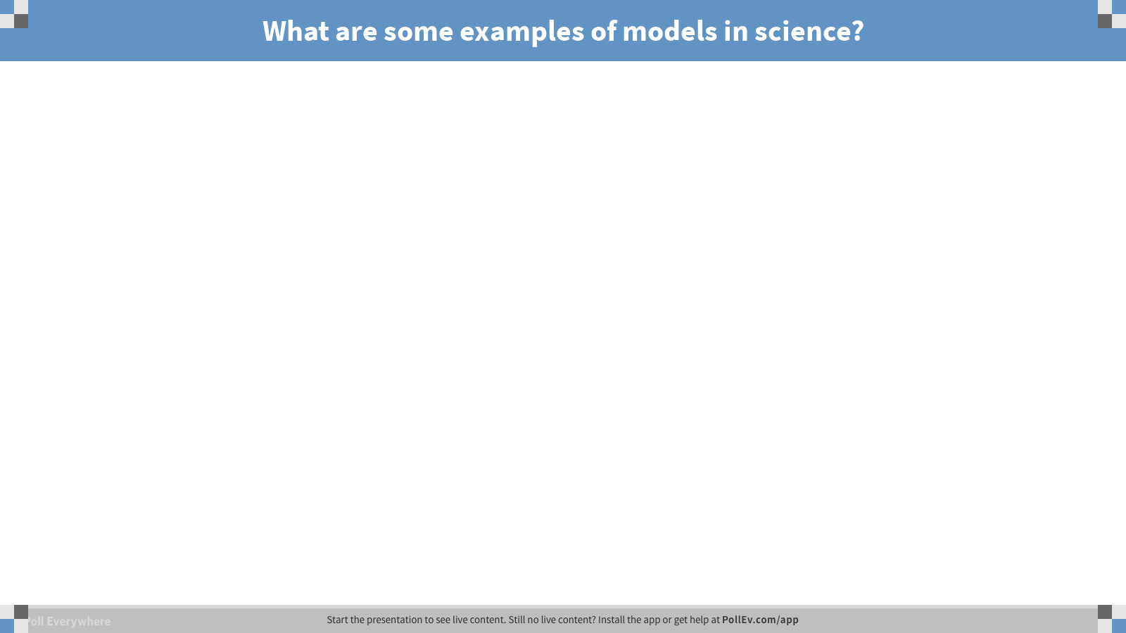
Notes:
What are some examples of models in science?
https://www.polleverywhere.com/free_text_polls/7TEfa8VczwBhjUJ

Slide 5
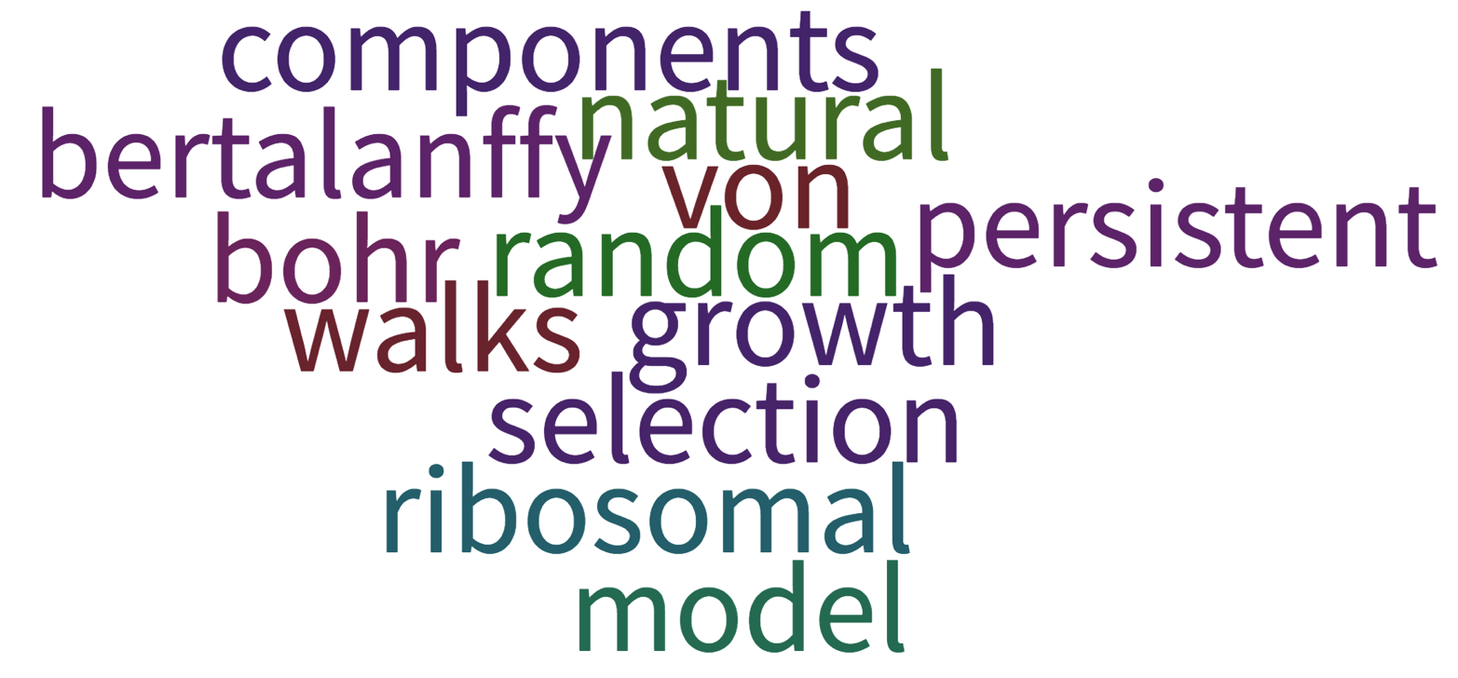
Word cloud!
(this is more confusing than I intended…)
Scientific theories, cellular components, specific physical models, modeling classes — all great answers
Also worth noting: animal (e.g., mouse) models, cell lines, epidemiological models, anatomy diagrams

Slide 6
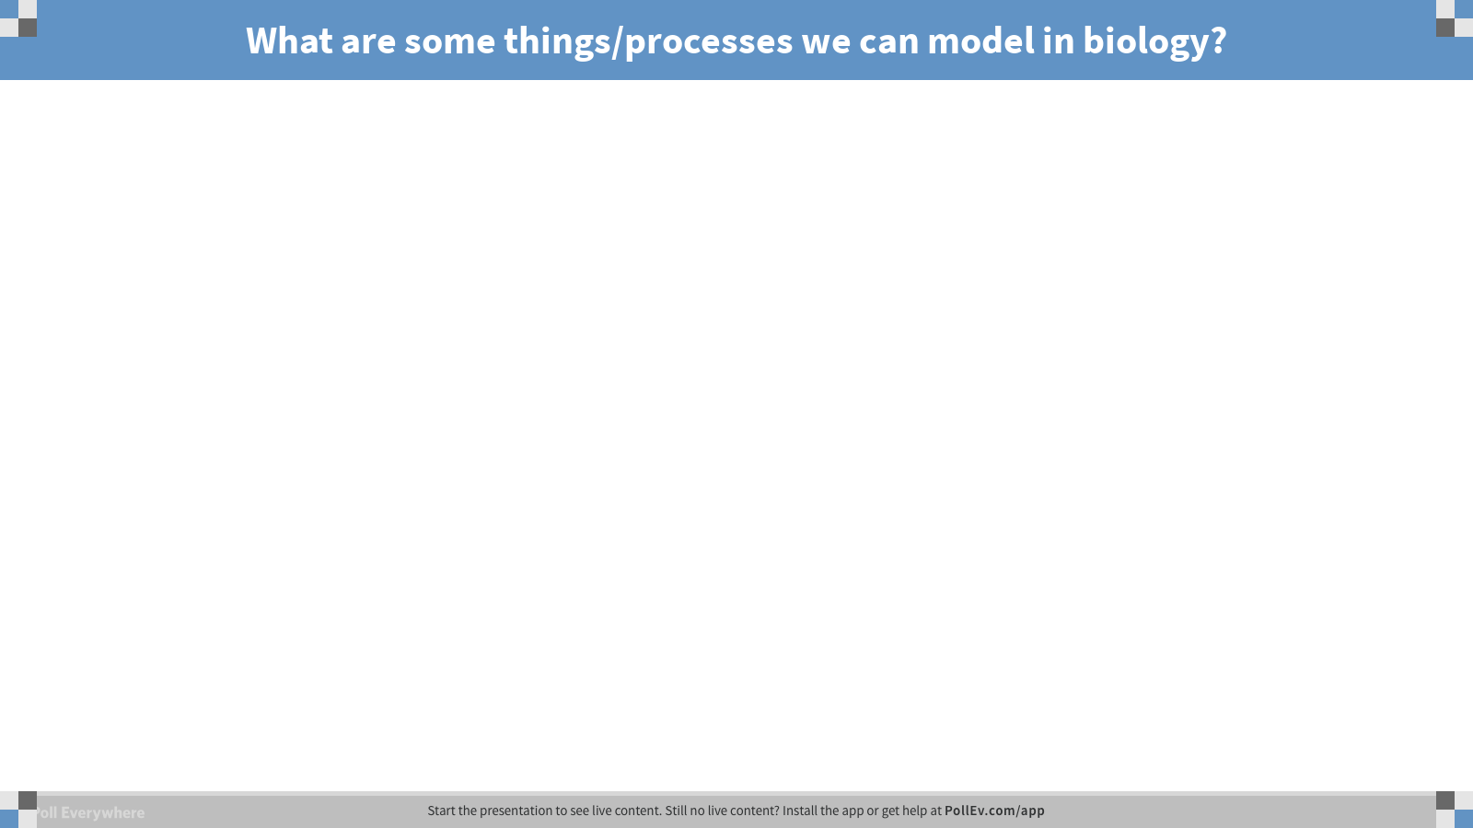
Notes:
What are some things/processes we can model in biology?
https://www.polleverywhere.com/free_text_polls/Hocm5DCbATtl2BM

Slide 7
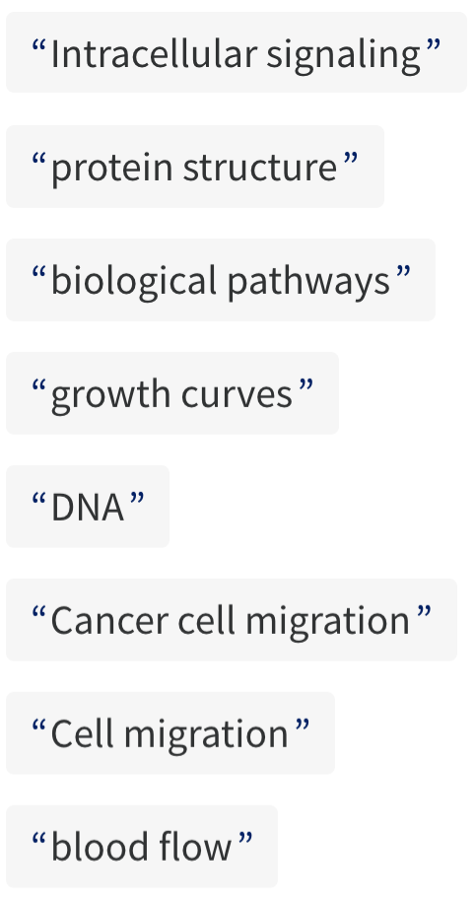
Some examples
Many, many more!

Slide 8
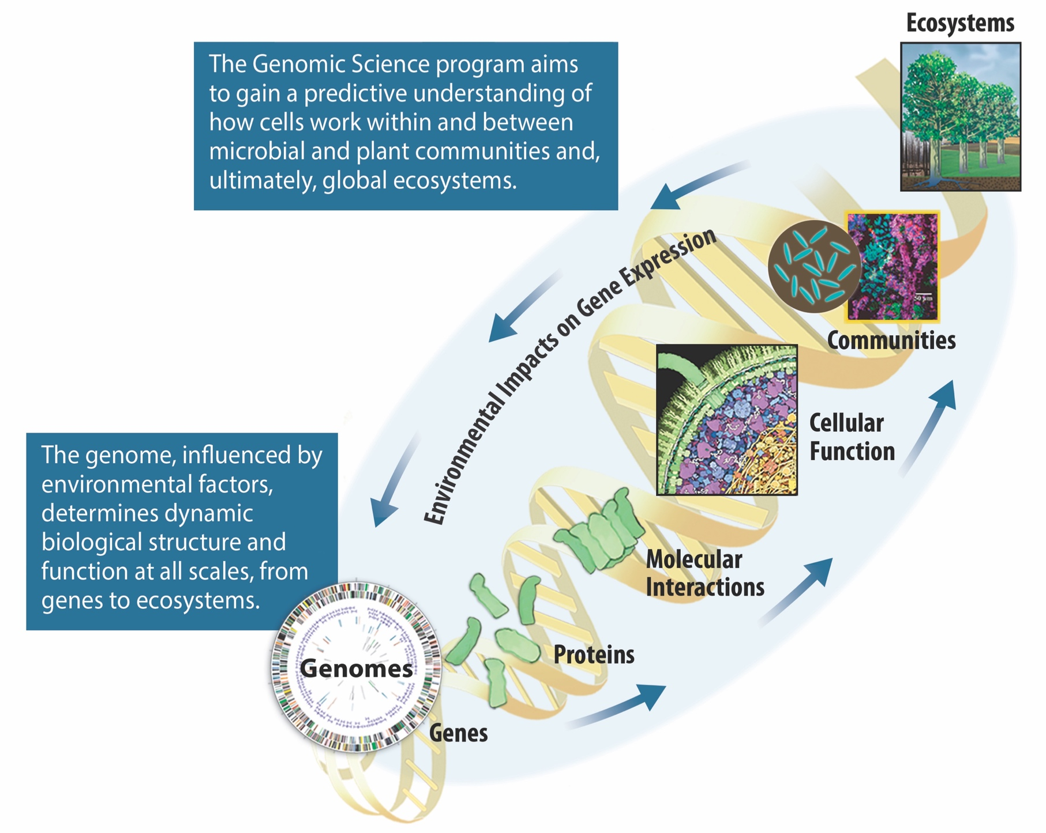
Modeling different biological scales
Defining the “system”
DOE Genomic Science Program
https://genomicscience.energy.gov/program/index.shtml

Slide 9
What is systems biology?
Toolbox for models of non-trivial scale
Beyond a few components, we lack the ability to effectively build or interpret models by hand/intuition
Mathematics and computation required, systems biology embodies this regime (large scales, complex)
Still very much reliant on good experimental data (and can also drive hypothesis generation)
Notes:
• By this definition, even a simple pathway diagram (for example, glycolysis or interacting signaling molecules in the cell cycle) constitutes a ‘model’.
• The challenge arises when trying to make sense of more than just a small handful of molecules interacting in a nonlinear way, where basic intuition and even
analytical methods aren’t up to the task of capturing the complexity of the system.
• It’s for these cases -- trying to model biological mechanism at scale -- that systems biology represents a toolbox, fully leveraging mathematical and computing
resources while (ideally) accounting for hard-earned experimental insights.

Slide 10
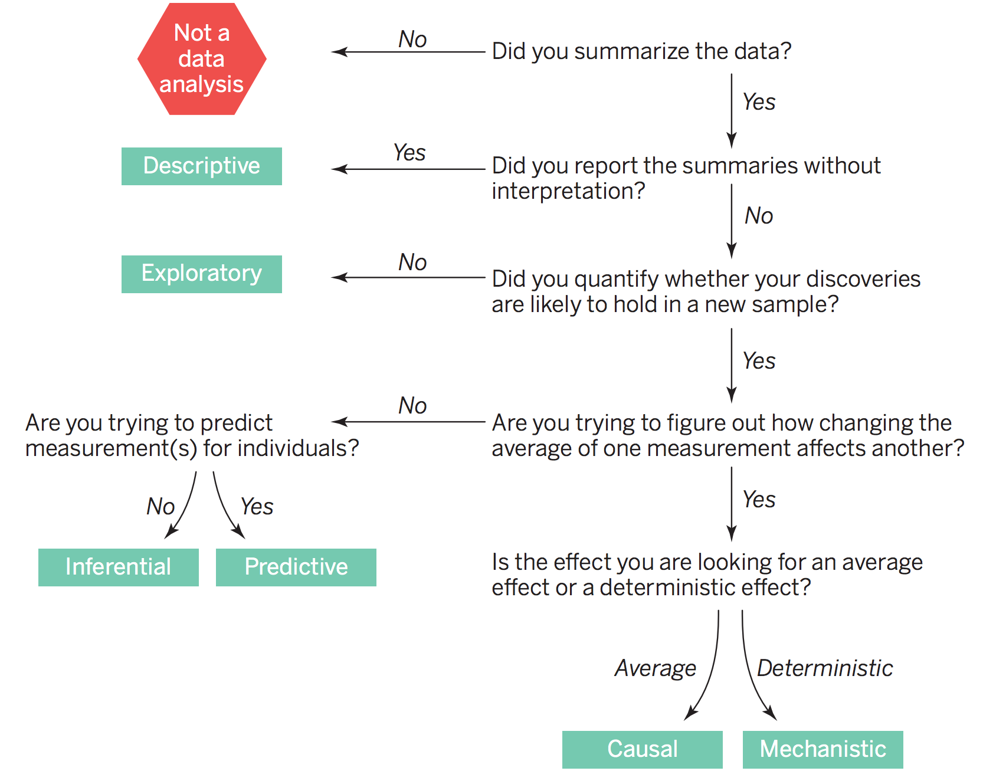
Stages of understanding in modeling
What is the question?
Answers you can hope to get from a model depend on the data used to build it (and also how it was designed)
Generalizable understanding of mechanism is a great goal, but not often feasible — especially in biology
Leek & Peng, Science 2015

Slide 11
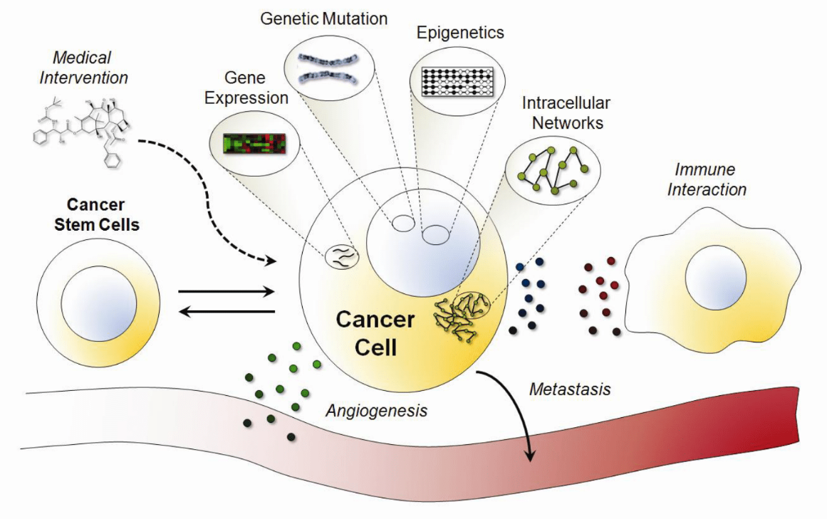
Bottom-up modeling is hard
Why not build detailed mechanistic models of everything?
Lack of data
Impossible to simultaneously measure everything
Context-specific behavior
Computational complexity
Edelman et al., WIRES Sys Biol & Med 2010

Slide 12
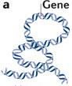
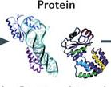


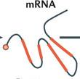
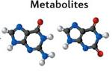
Top-down modeling is limited
Why not model everything from data?
Lack of data (still)
Measurements often indirect, noisy
Still just a snapshot
Need carefully designed experiments (and analyses) to determine causality
Genomics
Proteomics
Transcriptomics
Metabolomics
High Expression
gene 1
Low Expression
gene 2
…
“Omics” data analysis
~10,000 genes

Slide 13
Middle-out modeling?
No need to choose bottom-up or top-down, can leverage the strengths of both in iterative process (aka. “science”)

Slide 14
Modeling lifecycle
Eddy et al., Trends Cell Biol 2015
Notes:
• Tools and approaches in systems biology can be broadly grouped into top-down modeling or inference and bottom-up model construction.
• Each process contributes to biological understanding -- even in the absence of breakthrough discoveries -- whether by cataloging and curating existing knowledge and data; systematically identifying gaps and inconsistencies in that data; determining putative functions, interactions, and patterns; or predicting network behaviors in different conditions.
• However, for these tools and the resulting information to have the greatest utility to other biologists, they must be accurate (a given..), relevant, interpretable, and --
increasingly -- open and reproducible.

Slide 15
What’s in a name?

Slide 16
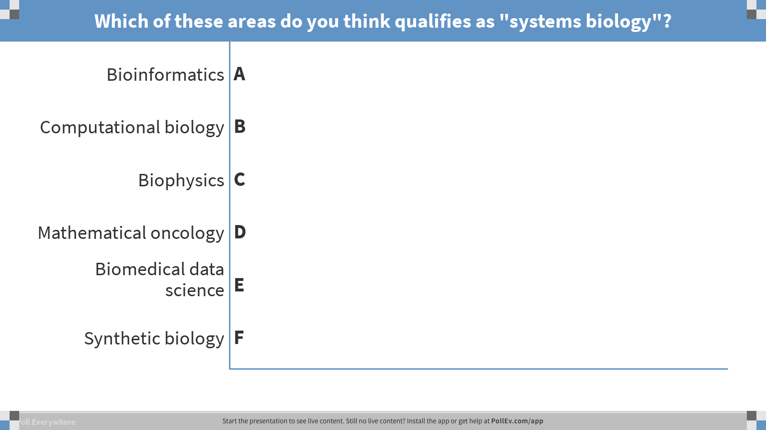
Notes:
Which of these areas do you think qualifies as "systems biology"?
https://www.polleverywhere.com/multiple_choice_polls/5HRMRQymG1eEr88

Slide 17
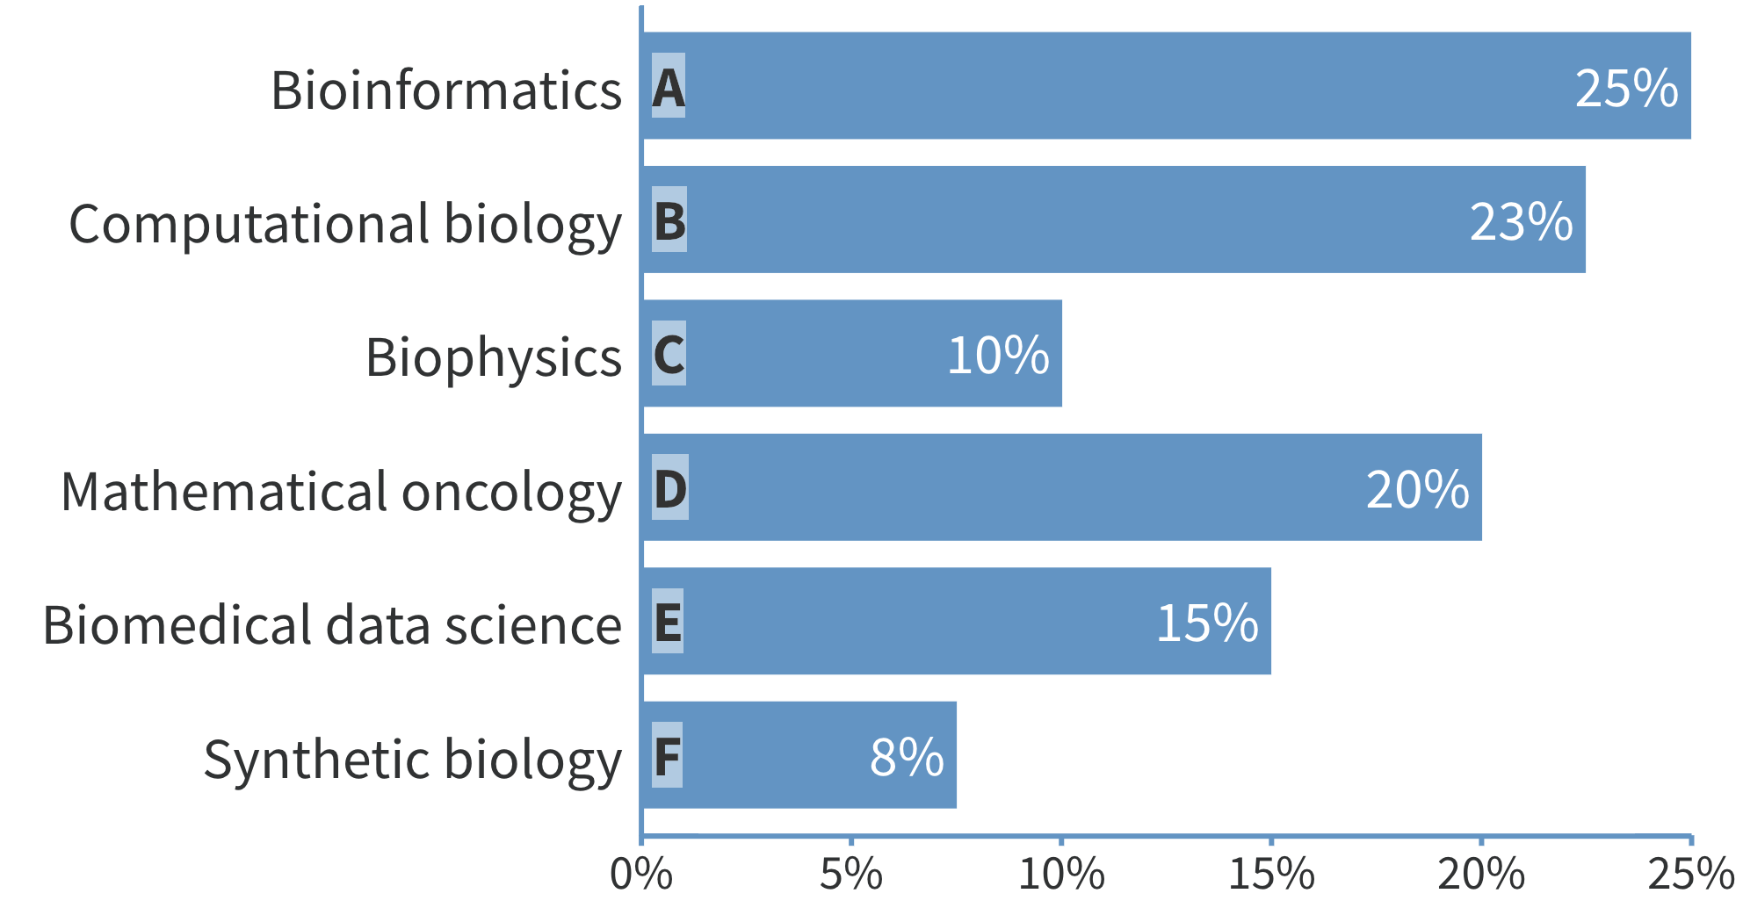
Answer: all of the above!

Slide 18
Emphasis on “toolbox”
Lots of complementary tools and approaches… don’t get hung up on semantics!

Slide 19
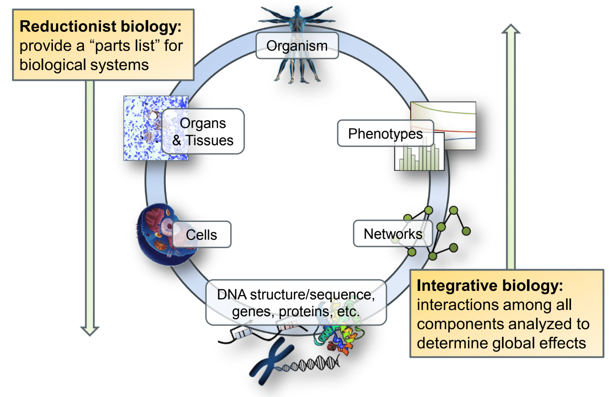
Integrative vs. reductionist biology
Notes:
Take differential expression analysis for example: examining genes one at a time is fairly “reductionist” in essence and doesn’t utilize or attempt to construct a systems level model of phenotypes — however, wouldn’t be feasible without technologies for measuring systems-level information or computational tools to model ~10k genes efficiently

Slide 20
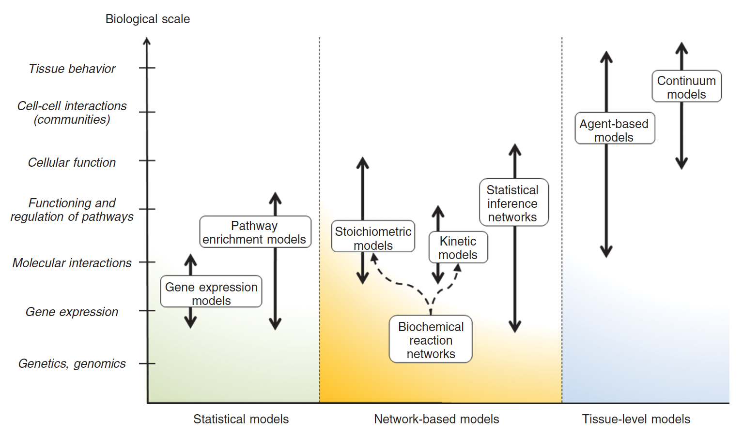
Flavors of (computational) systems biology models
Edelman et al., WIRES Sys Biol & Med 2010

Slide 21
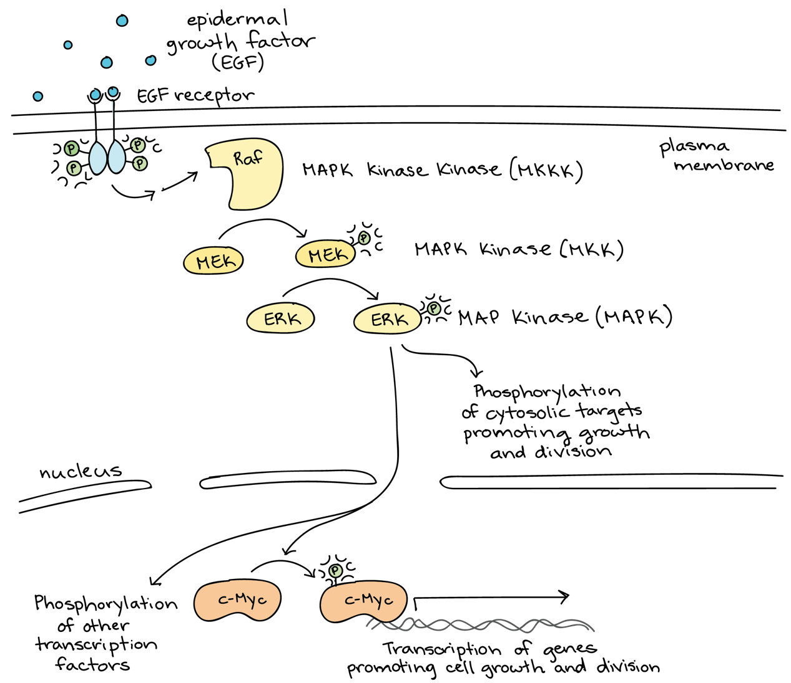
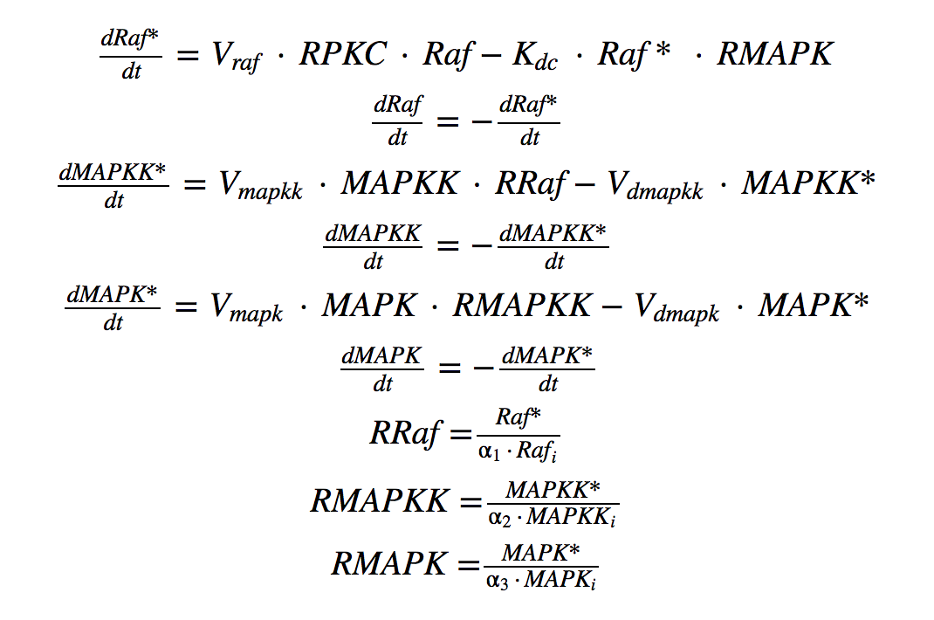
Kinetic/dynamic modeling
Mathematical modeling of physical & chemical properties
Systems of equations (e.g., ODE, PDE) describing reaction rates based on conservation laws, regulation patterns, and (sometimes) probability
Used to simulate continuous changes in time and space
More intuitive (direct) representation of biomolecular systems — difficult to build, get prohibitive to compute
https://www.khanacademy.org/science/biology
Luke et al., Dose Response 2010

Slide 22
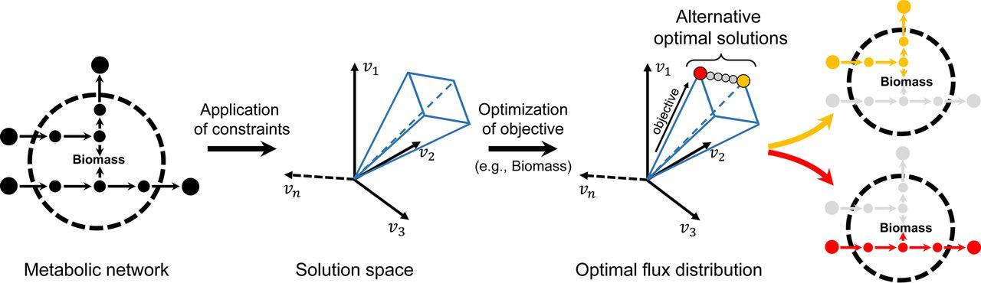
Constraint-based modeling
“Once you eliminate the impossible, whatever remains, no matter how improbable, must be the truth” ~ Sherlock Holmes (Arthur Conan Doyle)
https://ninesilos.wordpress.com/2014/06/20/what-if-sherlock-holmes-is-real/
Kinetic rules abstracted to stoichiometric reactions (number of molecules in and out); conservation of mass used to solve for reaction fluxes through system
Emphasis on what’s not feasible (invalid reactions, unreachable flux ranges); explore bounded solution space and simulate effect of perturbations within it
Bauer & Thiele, mSystems 2018
Notes:
kinetic rules are abstracted to stoichiometric reactions (number of molecules in and out);
conservation of mass used to solve for reaction fluxes through system - emphasis on what's not allowed (invalid reactions, flux bounds);
additional assumptions used to optimize for certain objectives (growth), predict the effect of internal flux changes

Slide 23
Network inference
Learning networks & network activity from data
Relationships inferred from data or depicted in simplified (not strictly stoichiometric) ways
Relationships between molecules, cells, etc. defined as binary events (binding), association (correlation, mutual information), influence (activation/inhibition) — or other forms, depending on the question
Often at least some biological knowledge (e.g., TF binding motifs) used to constrain statistical inference
https://systemsbiology.org/about/what-is-systems-biology/

Slide 24
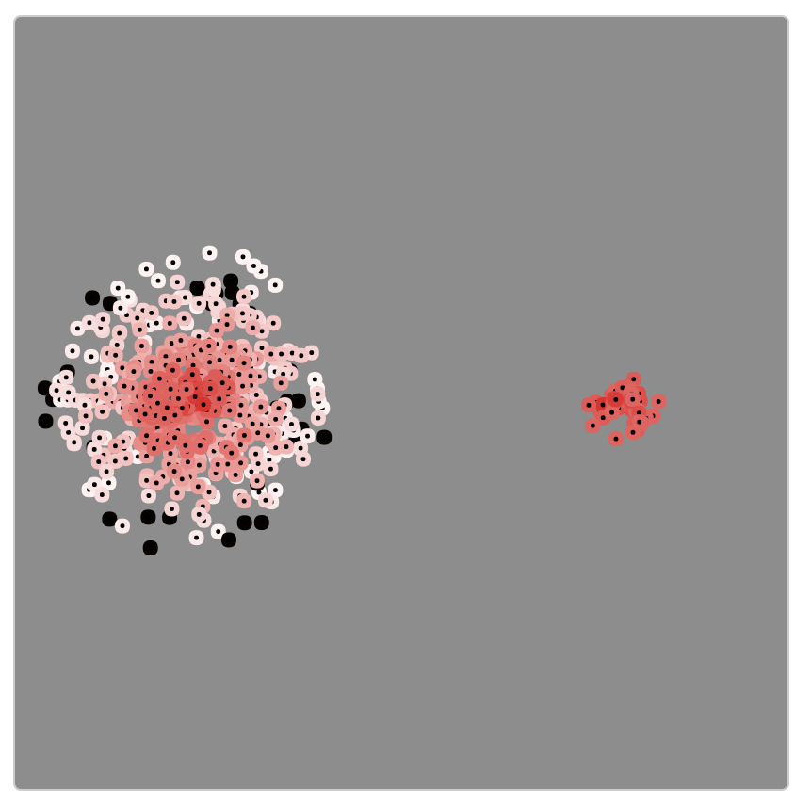
Agent-based modeling
NetLogo Tumor model
Emergent phenomena from interacting agents
Agents: units with defined rules governing their behavior or response — can interact with other agents or environment
Systems simulated in discrete time and space
Global behaviors or patterns arise through “self-organization” — often could not have been characterized based on knowledge of individual agents
Powerful tool for modeling communities of molecules or cells
http://ccl.northwestern.edu/netlogo/models/Tumor

Slide 25
Multivariate statistical & machine learning
Modeling combinatorial patterns and interactions
Rather than model the association between phenotypes and single variables (genes), use weighted combination of molecular features
Statistical models tend to emphasize interpretation, while machine learning models emphasize predictive performance
Both can be informed by known biology, or examined in functional contexts (e.g., pathways) after the fact
g₁
g₂
g₂
g₁
g₃
g₄

Slide 26
From integrative models to model integration

Slide 27
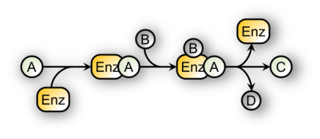


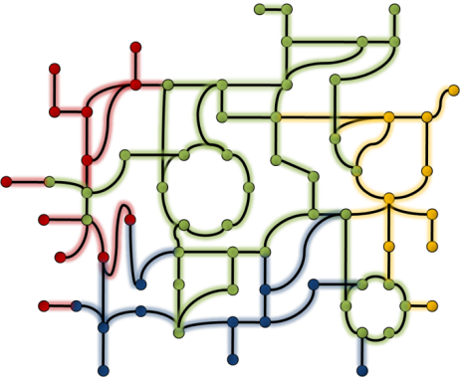
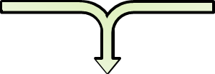
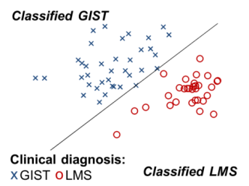
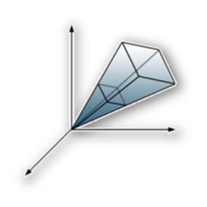
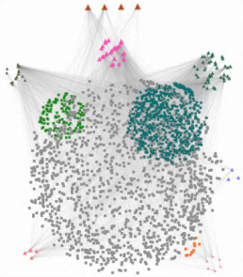
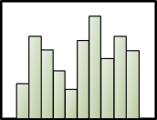
Statistical and mechanistic models
Normal cell
Tumor cell
Statistical models and inferred networks derived from high-throughput data
Biochemical reaction networks based on detailed mechanistic data
Integrating both approaches provides mechanistic context for high-throughput data
Notes:
Model parameters, structure derived from statistical predictions
Statistical predictions put into context
Statistical models constrained by mechanism

Slide 28
Statistical and mechanistic models
Cell Migration Simulator (CMS): mathematical model of cell adhesion dynamics
What are the steps that one might take to test model predictions experimentally, using the CMS predictions and the PS-ON data?
Q1. Using the CMS results in Figure 6f (regarding random motility coefficient, i.e. migration speed), identify a condition or set of conditions from the PSON motility data set that may be used to test the model prediction.
Q2. Make a hypothesis for a trend you would expect to see in your experimental condition(s) based on the CMS motility results (Figure 6f).
Bangasser et al., Nat Comms 2017

Slide 29
Statistical and mechanistic models
Cell Migration Simulator (CMS): mathematical model of cell adhesion dynamics
The number of motors/clutches (high vs. low) — as represented by blue and red lines in the CMS plots — can be estimated by the expression of associated genes or pathways, in particular, those related to myosin and cell adhesion proteins.
Spring force is representative of the stiffness of the experimental growth substrate/surface. For example some of the PS-ON data is on 500 Pa or 30 kPa, providing two different stiffness conditions. Glass is stiffer than both hyaluronic acid and polyacrylamide. (Also worth noting: the published CMS results were for "polyacrylamide hydrogels," which is one of the conditions included in the PS-ON data — so an attractive choice!).
The motility coefficient is a summary metric than can be considered analogous to speed/distance from the PS-ON motility imaging data.
Bangasser et al., Nat Comms 2017

Slide 30
Starting from omics data
Previously characterized parameter?
No
Yes
Related to parameters in CMS?
No
Yes
Compare model predictions to PSON Cell line data
Increased or decreased protein expression
Adjust input parameter value(s)
accordingly
Analyze CMS output of motility and migration
Signaling pathway activation
Genomics and proteomics data
Cell Migration Simulator (CMS)
Motility and morphology data
Examine proteins and pathways related to candidate parameter(s)
Identify candidate parameter(s)
Explore input parameter value(s)
Measured observation changes between cell lines or cancer types
Analyze image data to compare cell lines or cancer types
How could observation be capture in CMS?
No
Previously characterized observation?
Yes
Brian Castle
Starting from motility and morphology data

Slide 31
Next time!
Cell Migration Simulator & PS-ON modeling activity
Exploring our hypotheses using PS-ON data and statistical analysis in R!
Bangasser et al., Nat Comms 2017

Slide 32

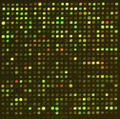
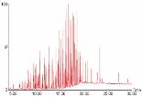
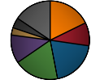
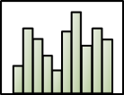
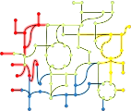
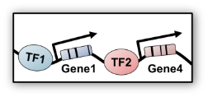

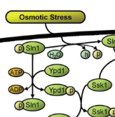
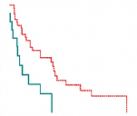


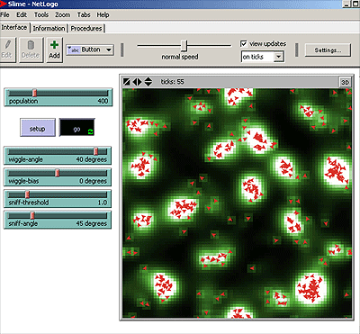
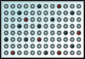
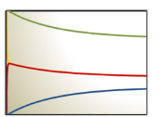
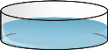
Integrative integration!
High-throughput phenotype- and patient-specific data
Constraint-based analysis for predictive simulation of disease mechanism
Transformed cell
Infected cell
Statistical analysis for identification of molecular disease signatures
Integration of transcriptional regulation, intracellular signaling, and dynamics
Virus
Experimental measurements, clinical data, and resident domain expertise
Immune cell
Multi-scale modeling of interactions between host and disease cells
Notes:
Mechanistic with rule-based (agent-based modeling and biochemical networks)
Mechanistic with mechanistic (different scales or processes connected by common elements and reactions)

Slide 33

Takeaways
Systems biology complements cell biology — it doesn’t replace it
Top-down and bottom-up modeling approaches each have advantages, depending on context and data available
Idealized cycle includes experimental investigation, data generation, systems-level modeling, and mechanistic characterization (rinse and repeat as needed)
Don’t get tripped up or discouraged by semantics and naysayers
Data* — and the question you’re trying to ask with it — are always the most important things! * open science, data sharing means better models for everyone!

Slide 34
Thanks!
Want to learn more?
Questions?
Email: james.eddy@sagebionetworks.org
Twitter: @jamesaeddy
Resources on the mini-DREAM Synapse page
(see Additional Resources)
Systems Biology & Bioinformatics
Courses, tutorials, and other resources to learn more about the use of mathematics, statistics, and programming for biomedical research applications.

